Slide 1
Introduction to ITSC Services
BNU - HKBU
United International College
New Staff Orientation
-Suri Li

Slide 2
ITSC
信息科技服务中心
Information Technology
Services Centre
Information Technology Service Center
(信息科技服务中心)

Slide 3
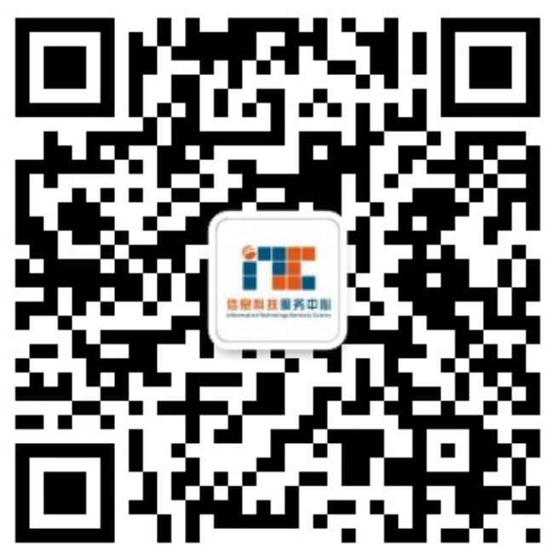

Slide 4
01
- How to connect to campus WiFi
- A) How to login to MIS system (UIC Portal) and where to find it. B) How to change your account password
02
03
- How to login to UIC email
CONTENTS
04
- How to request for IT service
05
- How to use printer
06
- How to Use Central Control Panel in the Classroom (For Teaching Staff)

Slide 5
01
How to connect to campus WiFi

Slide 6
UIC Wi-Fi
How to connect the Wi-Fi of UIC (Laptop)
Wi-Fi@UIC
UIC-WiFi
Click for Video
How to connect the Wi-Fi of UIC (Mobile)
Click for Video

Slide 7
02
A) How to login to MIS system (UIC Portal) and where to find it. B) How to change your account password

Slide 8
UIC Portal & MIS & Change Your Password
UIC Official Website: https://uic.edu.hk/en/
Enter your account and password in UIC Portal
Select MIS
Change your password
Click for Video

Slide 9
03
How to login to UIC email

Slide 10
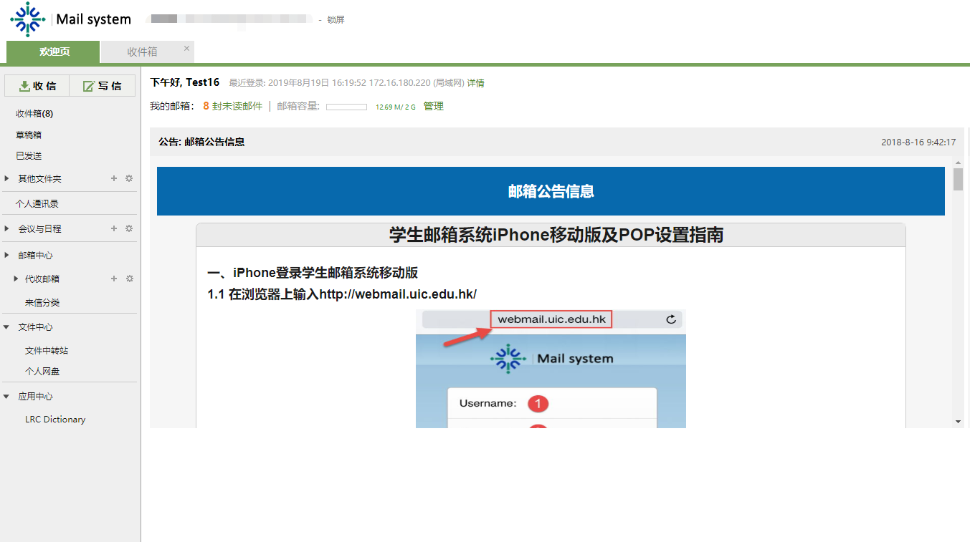
Mailbox
Directly to UIC mail page https://uicmail.uic.edu.hk
Or through UIC page https://uic.edu.hk
Click for Video

Slide 11
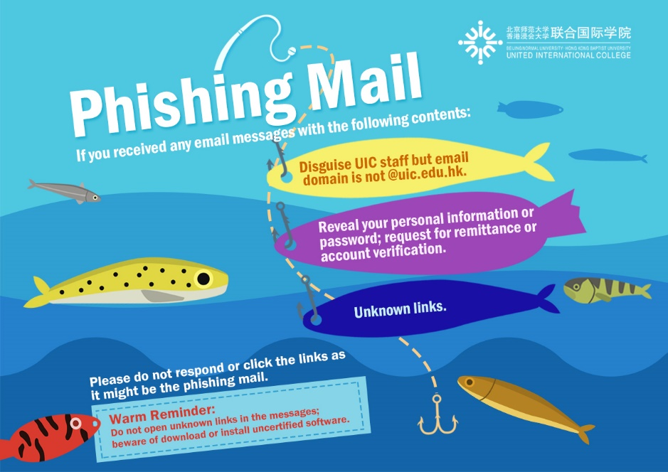

Slide 12
04
How to request for IT services

Slide 13
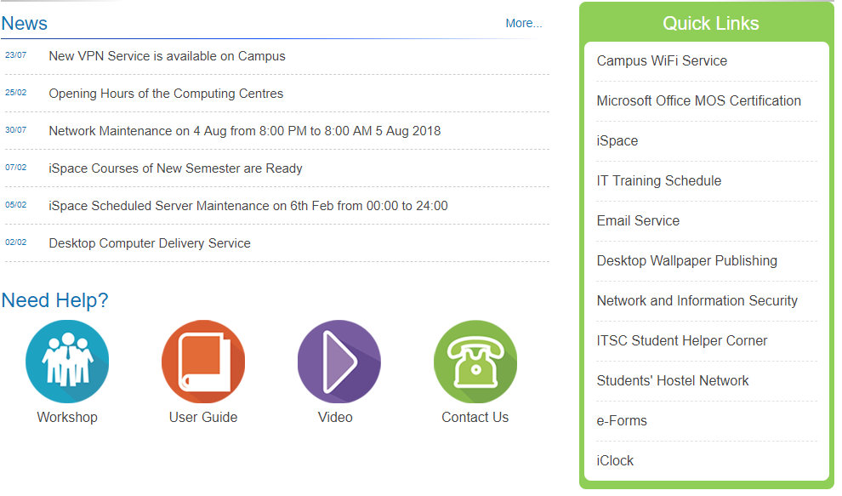
IT Service Application
How to request for IT Service
Click for Video

Slide 14
05
How to use printer

Slide 15
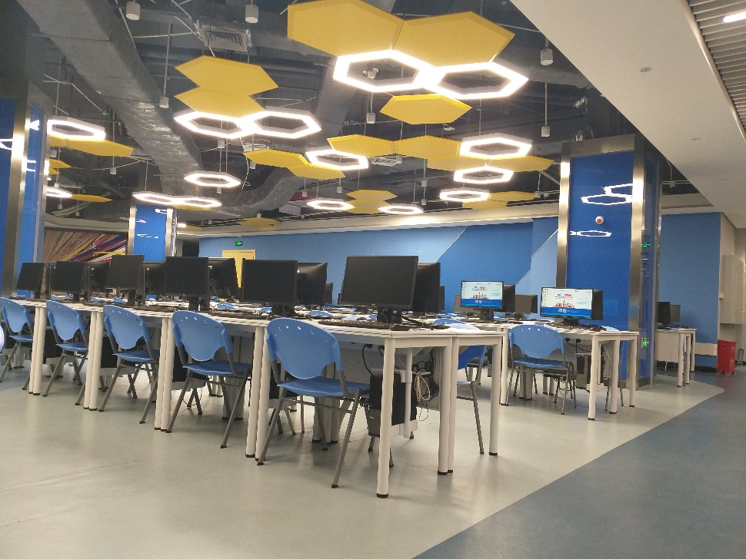
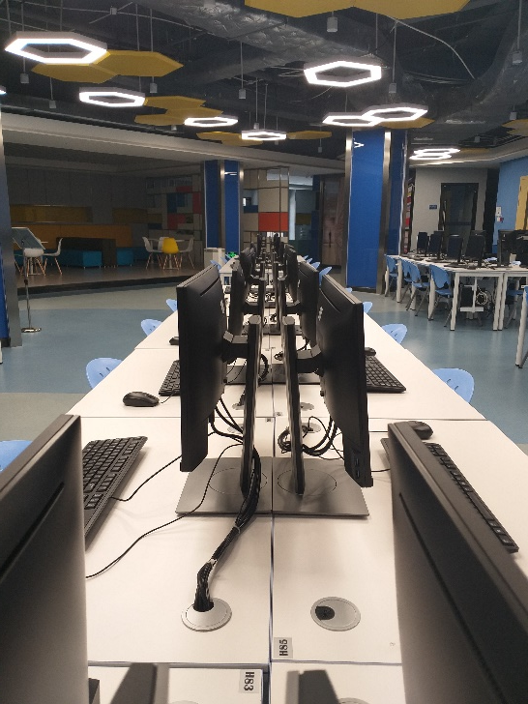
Printing Service
You will need your UIC card to have printing access
Click for Video

Slide 16
06
How to Use Central Control Panel (For Teaching Staffs)

Slide 17
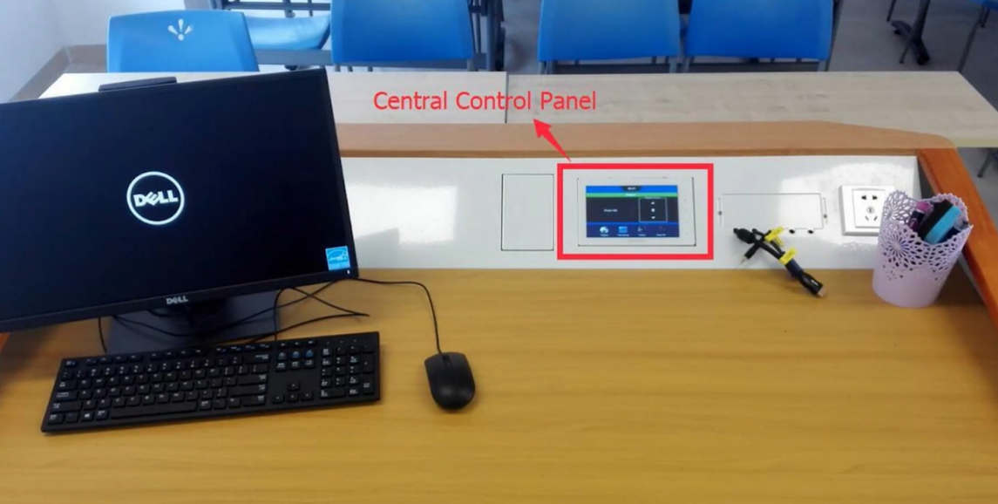
How to Use Central Control Panel in the Classroom (For Teaching Staffs)
Click for Video

Slide 18
07
Contact Us

Slide 19
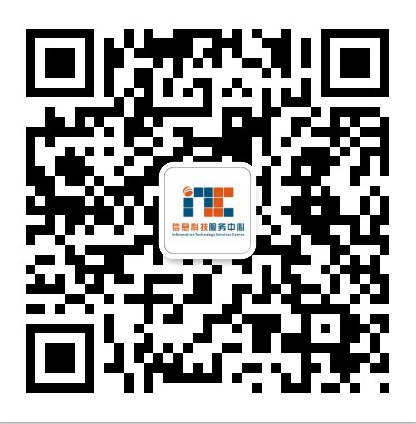
Contact Us
Location: | T8-202
Hotline: | (86-756) 3620315 ext.:8315
Email: | itsc_support@uic.edu.hk
Website: | http://itsc.uic.edu.hk
Office Hours: | Monday to Friday 8:30 a.m.-12:00 noon and 1:00 p.m. -5:30 p.m.
ITSC Wechat:UIC-ITSC

Slide 20
Questions?

Slide 21
Thank You!

